Slide 1
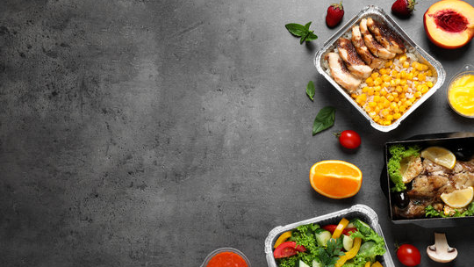
Food delivery Website
Food delivery
-Take your food on time
Team Members:
MADESHWARAN M A Rishi R
Mani Bala R

Slide 2

Problems
Choosing the right restaurants.
Quality of food.
Determining the serving of the food..
Comparing prices.

Slide 3

Objectives
Best quality of food.
All customers would be treated as same.
Easy to Compare the restaurants.
No premium customer, All are the same.

Slide 4
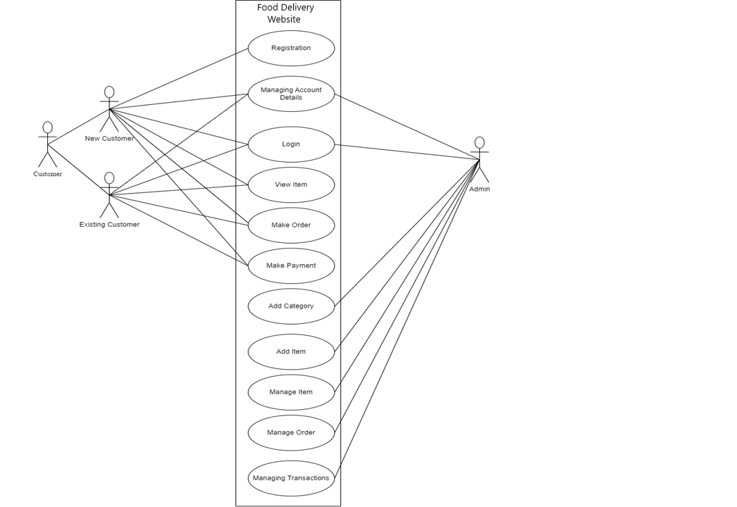
Use case diagram

Slide 5
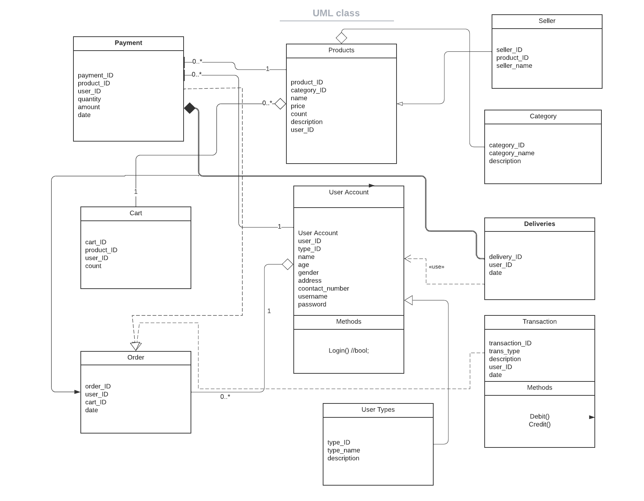
Class diagram

Slide 6
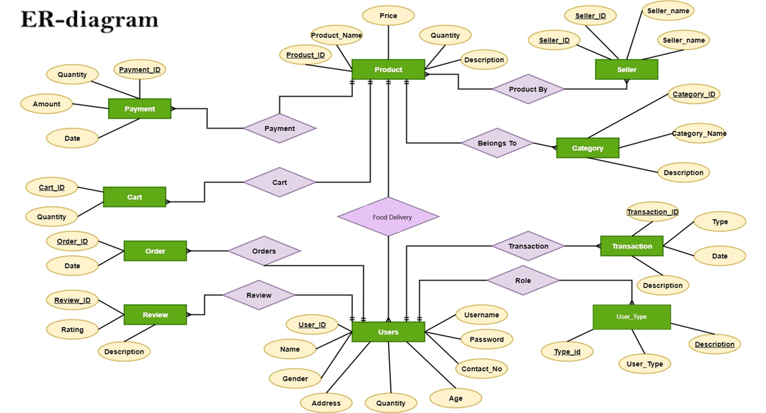

Slide 7

Technology Stack:
Frontend ReactJs
Backend SpringBoot
Database MySql
Testing Mockito, Junit
CodeCoverage EclEmma

Slide 8
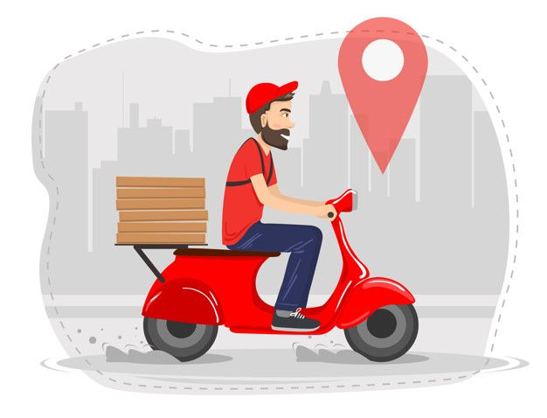
Thank You

